Slide 1
Cairn Alumni Search Mockup
by Tyler Carrier

Slide 2
Desktop Application

Slide 3
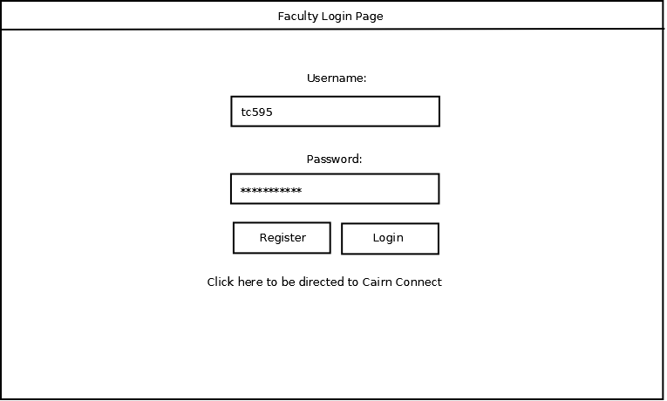
Faculty Login Page

Slide 4
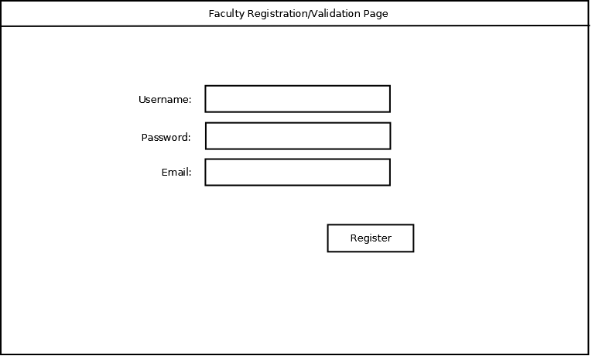
Faculty Registration/Validation Page

Slide 5
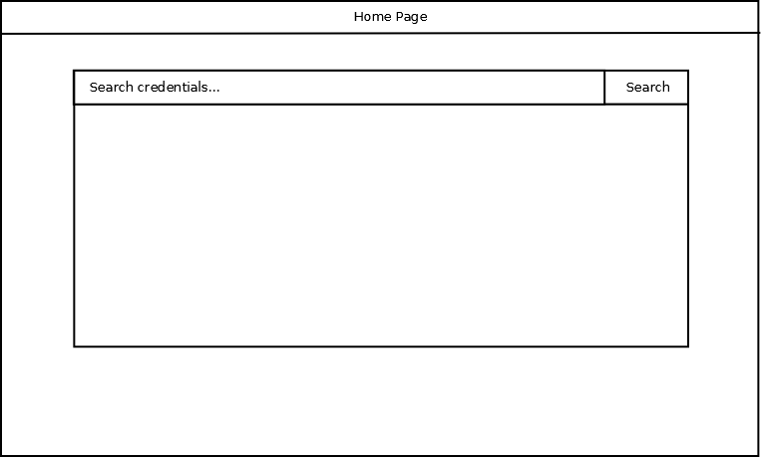
Home Page

Slide 6
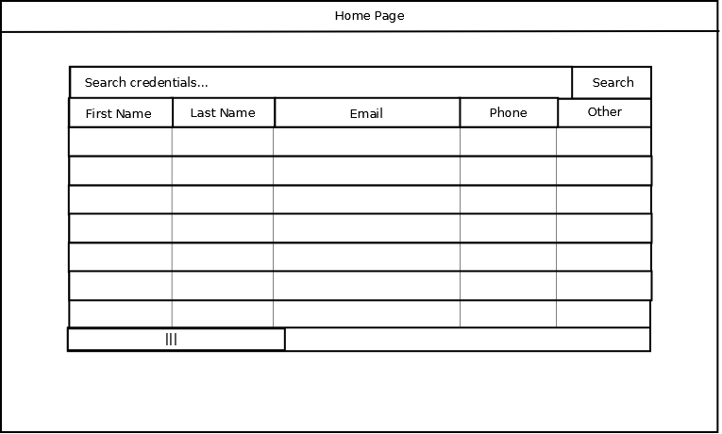
Home Page (results)

Slide 7
Web-based Application

Slide 8
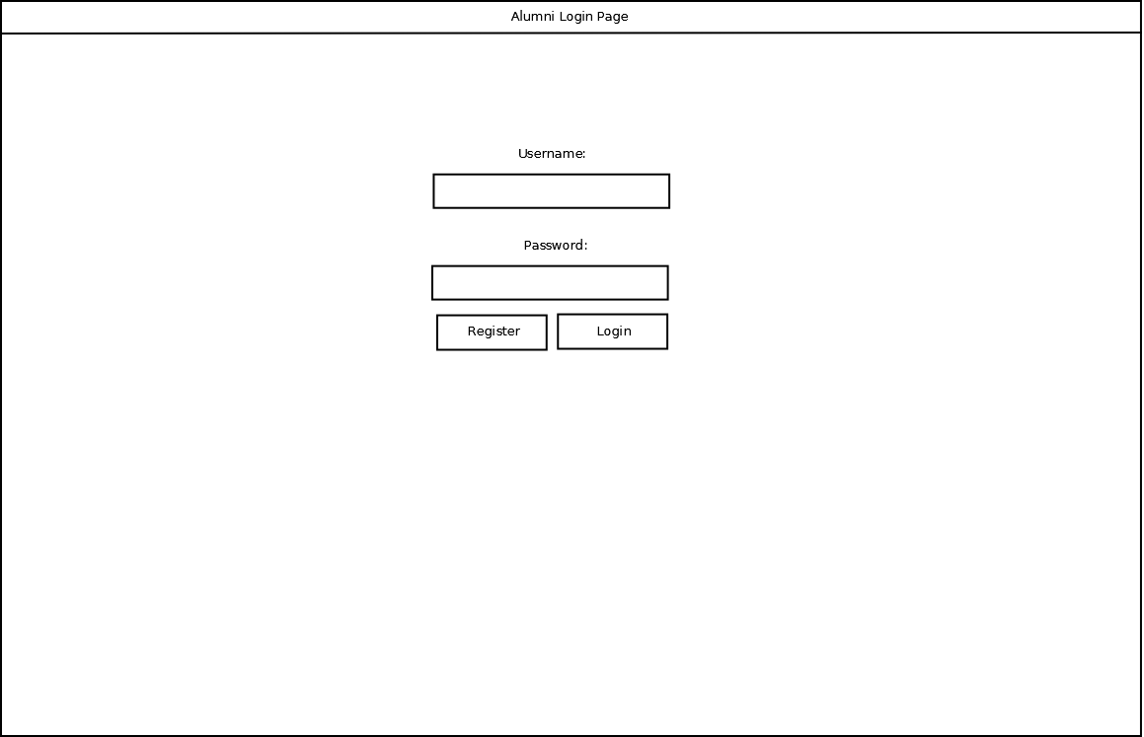
Alumni Login Page

Slide 9
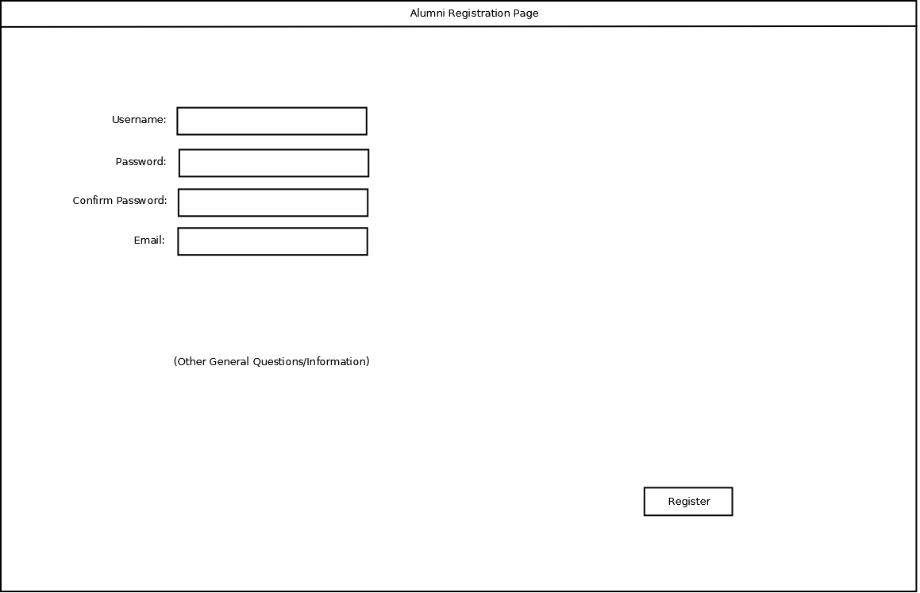
Alumni Registration/Validation Page

Slide 10
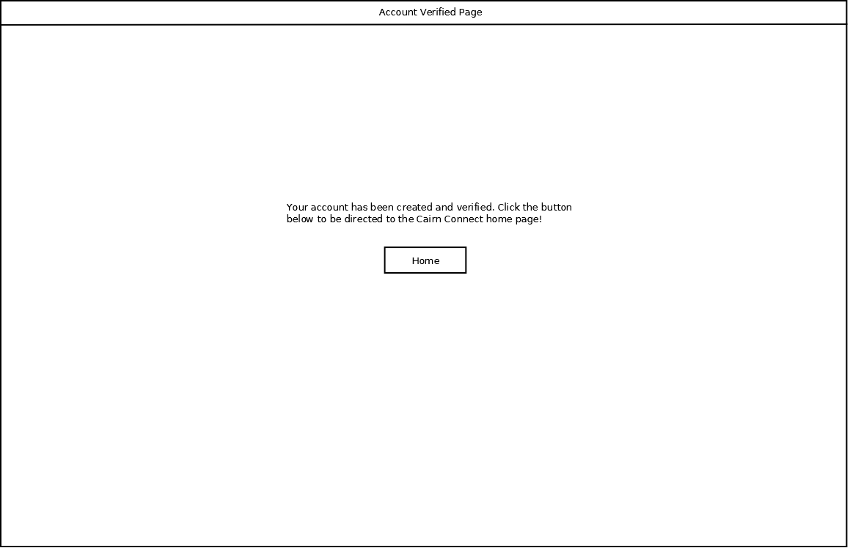
Account Verified Page

Slide 11
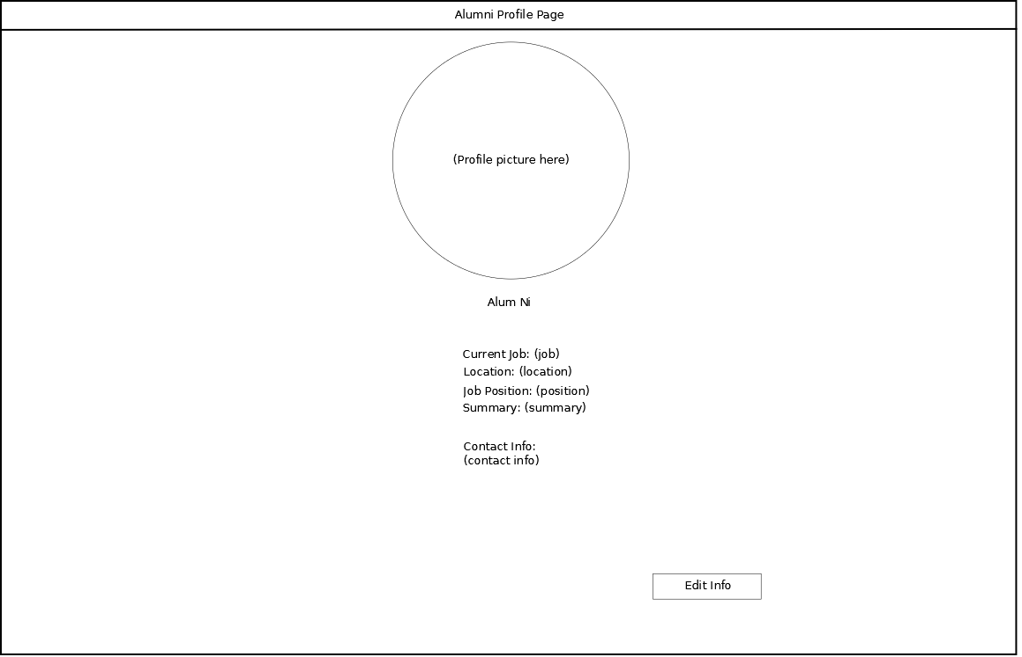
Alumni Profile Page

Slide 12
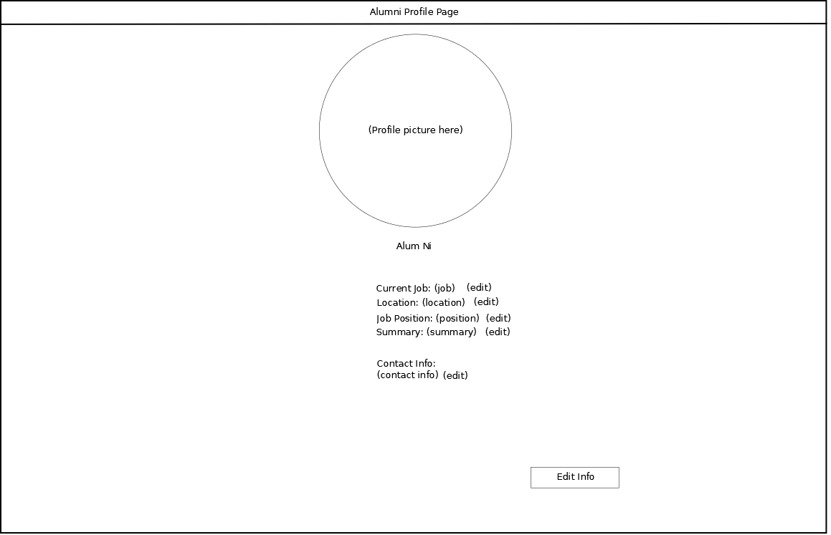
Alumni Edit Page

Slide 13
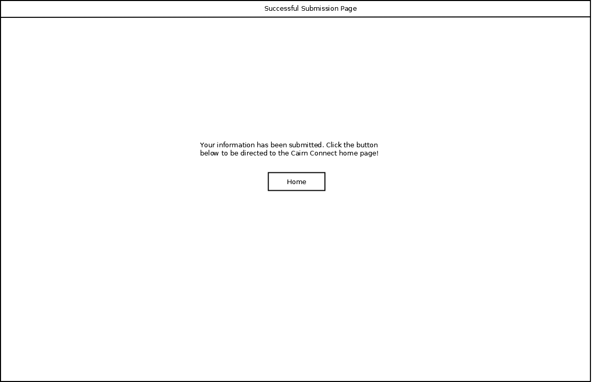
Successful Submission Page

